Slide 1

JMeter Performance
Dima Ionut Daniel

Slide 2
Contents
What is JMeter ?
Features
Core
Performance
Bibliography

Slide 3

What is JMeter?
100% pure open source java application from Apache project (http://jmeter.apache.org/)
Load testing tool for analyzing and measuring the performance of a variety of services and can be used as a unit test tool.
It can be used for regression and performance.
JMeter is extensible, its architecture is based on plugins, full multithreading framework.
the GUI design allows faster operation and more precise timings.
JMeter is documented .
The results can be retrieve and loaded into analyzers.

Slide 4
Features
Performance tests of different server types, including web (HTTP and HTTPS), SOAP, database, LDAP, JMS, mail, and native commands or shell scripts.
Complete portability across various operating systems.
Full multithreading framework allowing concurrent sampling by many threads and simultaneous sampling of different functions by separate thread groups.
In-built integration with real-time reporting and analysis tools, such as Graphite, InfluxDB, and Grafana.
Complete dynamic HTML reports.
Graphical User Interface (GUI).
HTTP proxy recording server.

Slide 5
Core
Once installed, the bin folder under the JMETER_HOME folder contains all the executable scripts that can be run.
JMeter files are saved as XML files with a .jmx extension.
jmeter.sh: This script launches JMeter GUI (the default)
jmeter-n.sh: This script launches JMeter in non-GUI mode (takes a JMX file as input)
jmeter-n-r.sh: This script launches JMeter in non-GUI mode remotely
jmeter-t.sh: This opens a JMX file in the GUI
jmeter-server.sh: This script starts JMeter in server mode
mirror-server.sh: This script runs the mirror server for JMeter
shutdown.sh: This script gracefully shuts down a running non-GUI instance
stoptest.sh: This script abruptly shuts down a running non-GUI instance

Slide 6
Core (cont.)
JMeter can run in non-GUI mode.
This is needed when we run remotely, or want to optimize your testing system by not taking the extra overhead cost of running the GUI.
-n: This command-line option indicates running in non-GUI mode
-t: This command-line option specifies the name of the JMX test file
-l: This command-line option specifies the name of the JTL file to log results to
-j: This command-line option specifies the name of the JMeter run log file
-r: This command-line option runs the test servers specified by the remote_hosts JMeter property
-R: This command-line option runs the test in the specified remote servers (for example, -Rserver1,server2)

Slide 7
Core (cont.)
JMeter provides two ways to override Java, JMeter, and logging properties.
One way is to directly edit jmeter.properties, which resides in the JMETER_HOME/bin folder.
The options available to include the following ones:
-D<property name>=<value> --> defines a Java system property value
-J<property name>=<value> --> defines a local JMeter property
-G<property name>=<value> --> defines a JMeter property to be sent to all remote servers
-G<property file> --> defines a file containing JMeter properties to be sent to all remote servers

Slide 8
Core (cont.)
Test plan is the root element of the JMeter scripts and houses the other components like: threads, config, timers, preprocessors, postprocessors, assertions and listeners.
By default, all thread groups are set to run concurrently.
A useful option when getting started is the Functional Test Mode and if checked, all the server responses returned from each sample are captured.

Slide 9
Core (cont.)
Thread groups represent the number of threads/users JMeter will use to execute the test plan.
All controllers and samplers for a test must reside under a thread group.
Each thread will execute the test plan completely independent of the other threads.
JMeter spins off multiple threads to simulate concurrent connections to the server.

Slide 10
Core (cont.)
Samplers send requests to the server and wait for a response.
Requests are processed in the order they appear in the tree.
Each of these has properties that can further be tweaked to suit your needs.

Slide 11
Core (cont.)
Test fragments is a special type of controller that is used for code reuse within a test plan.
They exist on the test plan tree at the same level as the thread group element and are not executed unless referenced either by an Include or Module Controller.

Slide 12
Core (cont.)
The listeners gather the results of a test run, allowing it to be further analyzed.
They allow us to define which fields are saved and whether to use CSV or XML format.
JMeter comes bundled with about 16 different listeners, all serving different purposes.
Some listeners, such as Assertion Results, Comparison Assertion Visualizer, Distribution Graph, Graph Results, Spline Visualizer, and View Results in tree, are memory and CPU intensive and should not be used during actual test runs.

Slide 13
Core (cont.)
By default, JMeter threads send requests without pausing between requests.
The timers causes JMeter to pause for a certain amount of time before each sampler that is in its scope.
Assertion components allow you to verify the responses received from the server.
In essence, they allow you to verify that the application is functioning correctly and that the server is returning the expected results.
Configuration elements work closely with a sampler, enabling requests to be modified or added to.
They are only accessible from inside the tree branch where you place the element.

Slide 14
Core (cont.)
A Preprocessor element, as the name implies, executes actions prior to a request being made.
Preprocessor elements are often used to modify the settings of a request just before it runs, or to update variables that aren't extracted from the response text.
Postprocessor elements execute actions after a request has been made.
They are often used to process response data and extract value from it.

Slide 15
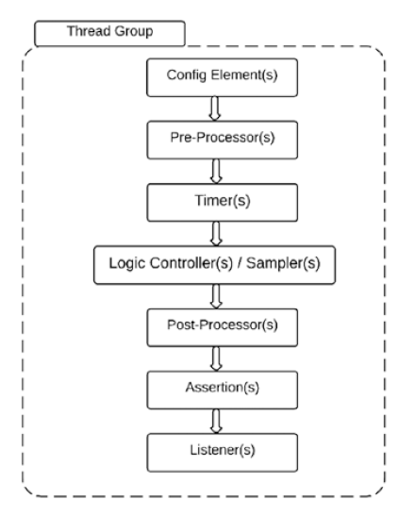
Core (cont.)
Order of execution

Slide 16
Performance
JMeter has inbuilt support for distributed testing.
This enables a single JMeter GUI instance, known as the master, to control a number of remote Jmeter instances, known as slaves, and collect all the test results from them.
This approach will:
save test samples to the local machine
manage multiple instances of JMeterEngine (slave nodes) from a single machine
replicates the test plan from the master node to each controlled server
without the need to copy them to each server

Slide 17
Performance
Performance testing is a non-functional testing performed to determine how a systems performs in terms of responsiveness and stability under a particular workload.
It can server to investigate, measure, validate or verify other quality attributes of the system.

Slide 18
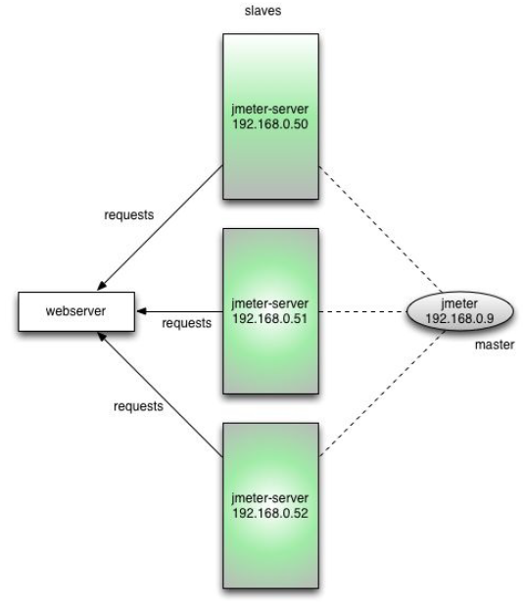
Performance (cont.)
JMeter doesn’t distribute the load between servers. Each server will execute the same test plan in its entirety.
The remote mode is more resource-intensive than running the same number of non-GUI tests independently.
If many server instances are used, the client's JMeter can become overloaded.

Slide 19
Performance (cont.)
Performance testing is the testing performed on a system or application to measure some of its attributes such as response time, throughput, scalability, etc.
These attributes are called the performance criteria.
Performance testing is different than functional testing.
In performance testing, we are primarily focused on speed, whereas functional testing is concerned with correctness of the application behavior.

Slide 20
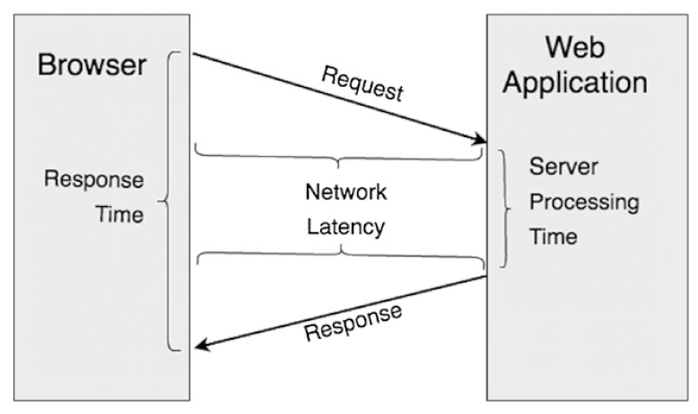
Performance (cont.)
The time taken by the application to respond to the user’s request is called the response time.

Slide 21
Performance (cont.)
A sequence of request/responses constitutes a transaction.
The number of transactions per unit time is called the throughput and it's measured in transactions/second or bandwidth (bytes/second).
It depends on server hardware, system load, and network latency.

Slide 22
Performance (cont.)
Types of Performance Tests
Stress Tests: tests the application beyond the normal limits.
Load Tests: test that’s performed at the specified load level.
Peak Load Tests: performed at the load that the application is expected to handle.
Soak Tests (Endurance Tests): the application is subjected to a specified load that is within the specified limit but for a long duration.
Scalability Tests: experience massive and sometimes exponential growth.
Capacity Tests: test that establishes the maximum load that the application can handle while meeting the desired performance criteria
Spike Tests(Burst Capacity): test where the application is subjected to brief periods of sudden increment in load, a small fraction beyond the maximum capacity.

Slide 23
Performance (cont.)
The endurance test will surface problems like:
Memory leaks in the application
Database connections exhaustion
Network connection exhaustion
Log files becoming full and log rotation
Other resource exhaustion

Slide 24
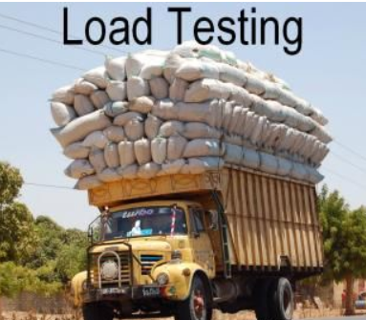
Performance (cont.)
Load/Capacity Testing
simplest form of performance testing, usually conducted to understand the behavior of the system under a specific expected load.
we can use a concurrent number of users on the application performing a specific number of transactions.
the test will give out the response times of all the important business critical transactions.

Slide 25
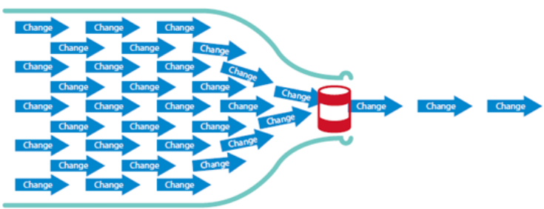
Performance (cont.)
A bottleneck can happen when the capacity of an entire system is limited by a single or limted number of components or resources.
Bottleneck in the application can be identified by performing the load test with the defined concurrent user load for various scenarios.

Slide 26
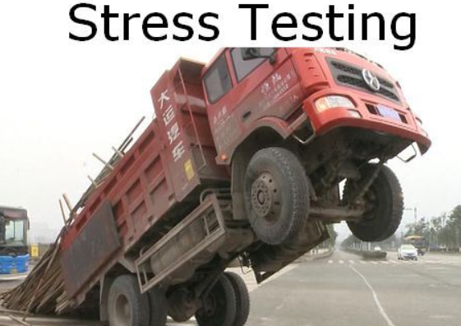
Performance (cont.)
Stress Testing
The purpose of the stress testing is to find the capacity limit of the system.
When the load goes beyond the limit, the application starts responding very slowly and even produce errors.
During this test we can verify at which point of time the system degrades of fails.

Slide 27
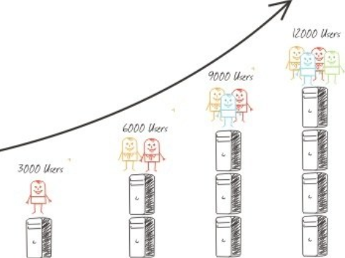
Performance (cont.)
Spike testing is done by suddenly increasing the number of the generated load.
The goal is to determine the performance degrade, system failure or how the system reacts.

Slide 28

Bibliography
Apress – Pro Apache Jmeter
Packt - Performance Testing with JMeter 3
https://www.slideshare.net/bhojanrajan/performance-testing-jmeter

